Slide 1

An app that enable tutors to list their services and parents to book time with tutors.
A P Krittika

Slide 2
Project overview
The product:
Its an app and a responsive website that enable tutors to list their services and parents to book time with tutors.
Preview of selected polished designs.
Project duration:
January,2025-

Slide 3
Project overview
The problem:
To find trustworthy, flexible, and tailored tutoring services for their children within their limited time.
The goal:
The goal is to ensure that the app provides easy access and reliable tutors to the users.

Slide 4
Project overview
My role:
lead UX designer, UX researcher
Responsibilities:
user research, wireframing, prototyping, etc.

Slide 5
User research
Personas
Problem statements
User journey maps
Understanding
the user

Slide 6
User research: summary
For this project, I conducted secondary research and informal interviews with parents and tutors to understand their needs and challenges when connecting for tutoring services. Initially, I assumed that parents prioritize cost and proximity over other factors, while tutors mainly focus on managing their schedules. However, the research revealed that parents value tutor credibility, specialization, and flexible booking more than cost, and tutors seek platforms that ensure a consistent workflow and transparent communication. These insights refined the app's core design to focus on trust-building features, robust filtering options, and seamless scheduling tools.

Slide 7
User research: pain points
1
2
3
4
Pain point
Pain point
Pain point
Pain point
Limited time to research and connect with tutors due to a busy work schedule..
Existing platforms are either expensive or lack credibility and detailed information about tutors.
Difficulty finding tutors who provide customized learning plans for Rohan’s specific needs.
Finding tutors and reading reviews is frustrating

Slide 8
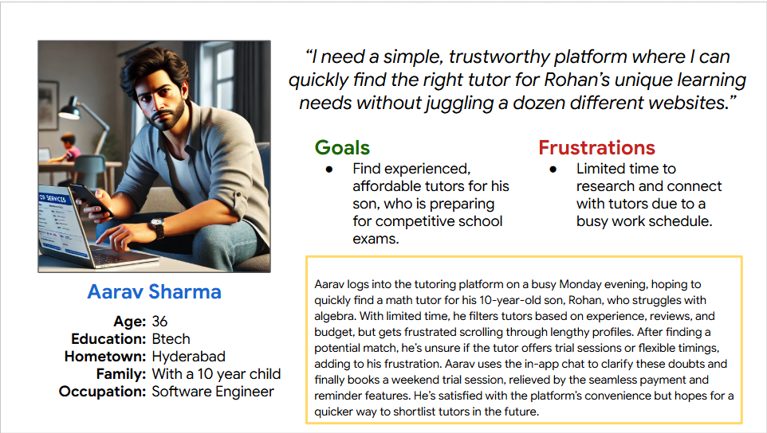
Persona: Name
Problem statement:
Aarav is a software engineer
who needs a tutor
because [insight].

Slide 9
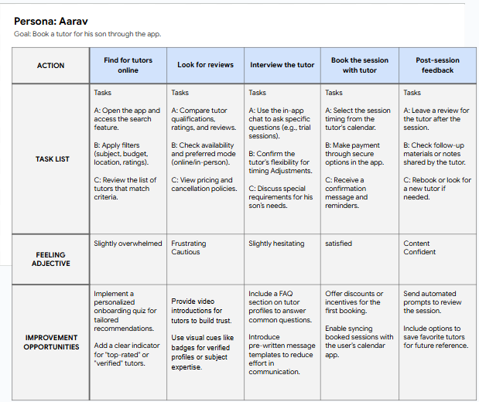
User journey map
[Your notes about goals and thought process]
Image of user journey map

Slide 10
Paper wireframes
Digital wireframes
Low-fidelity prototype
Usability studies
Starting
the design

Slide 11
Paper wireframes
[Your notes about goals and thought process]
Image of paper wireframes including five different versions of the same screen and one image of the new, refined version

Slide 12
Digital wireframes
Description of the element and its benefit to the user
[Your notes about goals and thought process]
Insert first wireframe example that demonstrates design thinking aligned with user research
Description of the element and its benefit to the user

Slide 13
Digital wireframes
Description of the element and its benefit to the user
[Your notes about goals and thought process]
Insert second wireframe example that demonstrates design thinking aligned with user research
Description of the element and its benefit to the user

Slide 14
Low-fidelity prototype
[Link to low-fidelity prototype and brief description of the user flow]
Screenshot of prototype with connections or prototype GIF

Slide 15
Usability study: findings
Write a short introduction to the usability studies you conducted and your findings.
Round 1 findings
Round 2 findings
1
Insert finding
1
Insert finding
2
Insert finding
2
Insert finding
3
Insert finding
3
Insert finding

Slide 16
Refining
the design
Mockups
High-fidelity prototype
Accessibility

Slide 17
Mockups
Before usability study
After usability study
[Your notes about goals and thought process]
Image of selected screen before usability study
Image of selected screen after usability study

Slide 18
Mockups
Before usability study
After usability study
[Your notes about goals and thought process]
Image of selected screen before usability study
Image of selected screen after usability study

Slide 19
Mockups
Main mockup screen for display
Main mockup screen for display
Main mockup screen for display
Main mockup screen for display

Slide 20
High-fidelity prototype
[Link to high-fidelity prototype]
Screenshot of prototype with connections or prototype GIF

Slide 21
Accessibility considerations
1
2
3
Insert one to two sentence summaries describing each accessibility consideration applied in your designs.
Insert one to two sentence summaries describing each accessibility consideration applied in your designs.
Insert one to two sentence summaries describing each accessibility consideration applied in your designs.

Slide 22
Going forward
Takeaways
Next steps

Slide 23
Takeaways
Impact:
Insert one to two sentences summarizing the impact of your designs. In the real world, you’d include data like number of downloads or sign ups, but since this is a course project, you can include a positive quote from a peer or study participant.
What I learned:
Insert a few sentences summarizing what you learned throughout the project.

Slide 24
Next steps
1
2
3
Insert a few sentences summarizing the next steps you would take with this project and why.
Insert a few sentences summarizing the next steps you would take with this project and why.
Insert a few sentences summarizing the next steps you would take with this project and why.

Slide 25
Insert a few sentences summarizing the next steps you would take with this project and why. Feel free to organize next steps in a bullet point list.
Let’s connect!
Insert a brief sentence or two about contacting you and/or reviewing more of your work.
Provide your contact information here. This might include your email address, phone number, and website or link to other professional platforms.

